Slide 1






Project
Shopner Bangladesh
A Centralized Database System
Presented by Team_Innova_Trio

Slide 2




OUR TEAM
Md. Mizanur Rahman
Shahid Al Mamim
Lamia Akter Jesmin

Slide 3

Project Overview
Database System for Village Development Planning
Objective: Develop a database system to assist government and investors in identifying underdeveloped villages.
Purpose: Facilitate data-driven decisions for infrastructure, healthcare, education, and economic development.
Focus: Collect and manage data on districts, upazilas, and villages for strategic resource allocation.

Slide 4

Challenges in Development Planning
Lack of centralized data for rural areas
Difficulty in identifying critical needs and resource gaps
Poor quality in the available data and lack of data in many sectors
Inefficient planning due to limited insights into population, infrastructure, and economic conditions
Need for a database-driven approach to improve decision-making and investments

Slide 5
Database Solution for Rural Development
A relational database to store and manage village-level data
Key Features:
Comprehensive data on population, infrastructure, education, healthcare, and economy.
Easy access to development indices and priority areas.
Tools to identify high-priority regions for targeted investments.

Slide 6
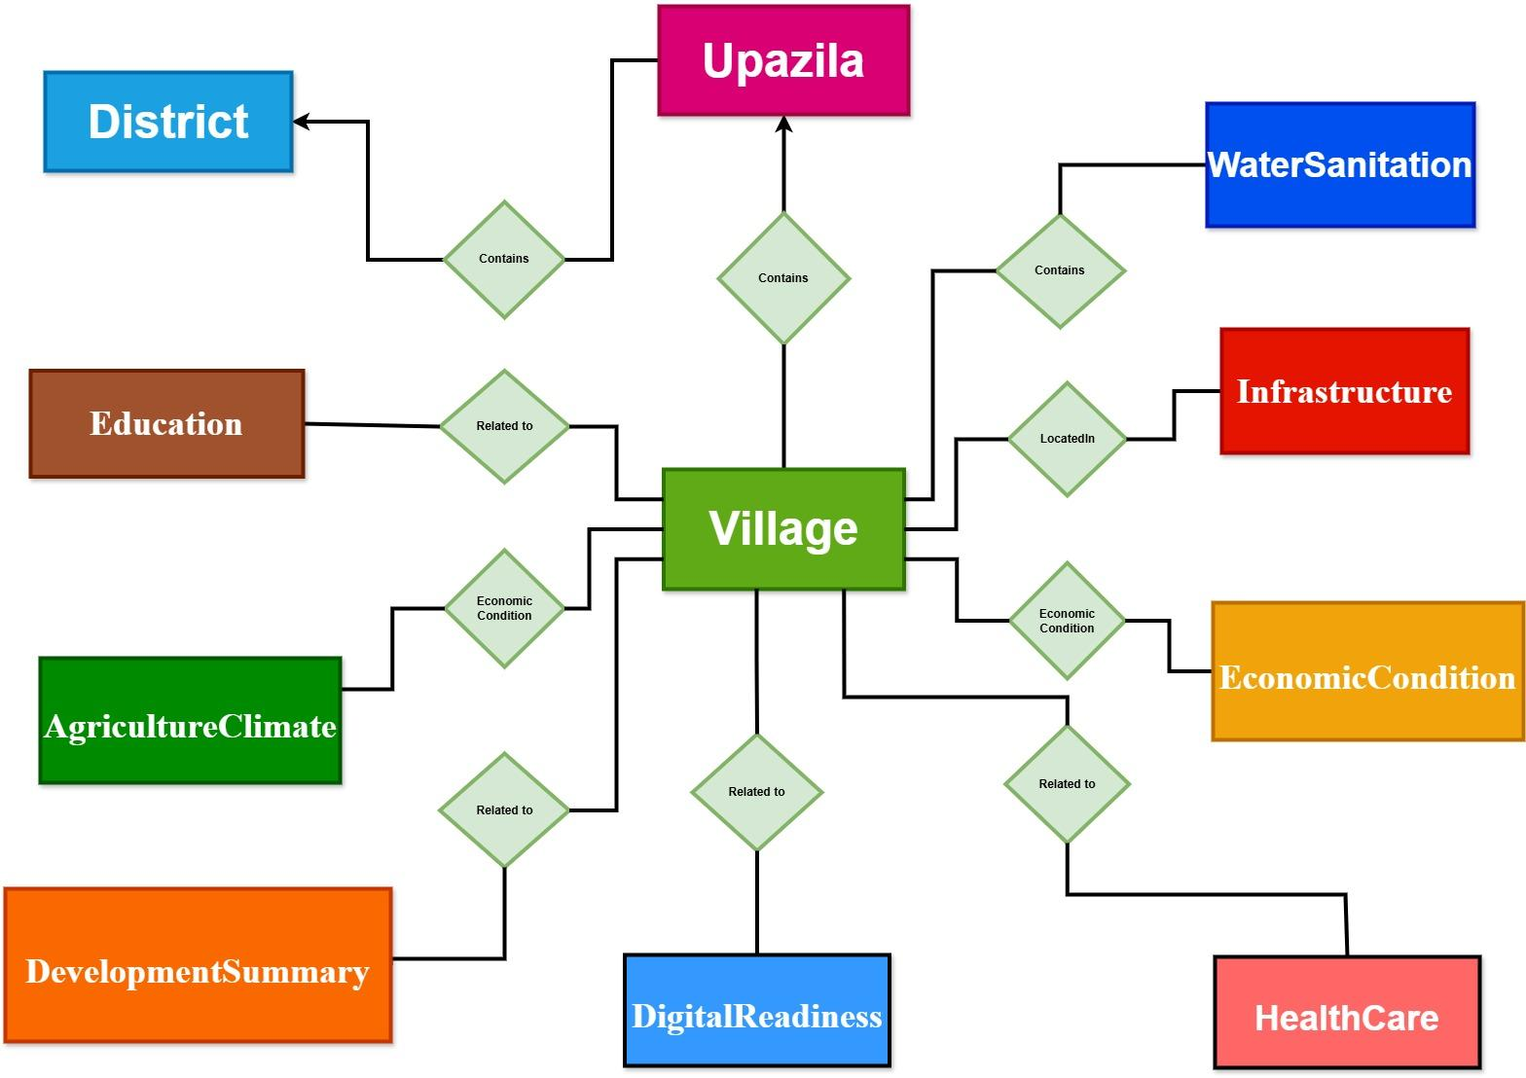

ER Diagram
Visual representation of the database structure
Shows entities and relationships between tables
02
03

Slide 7
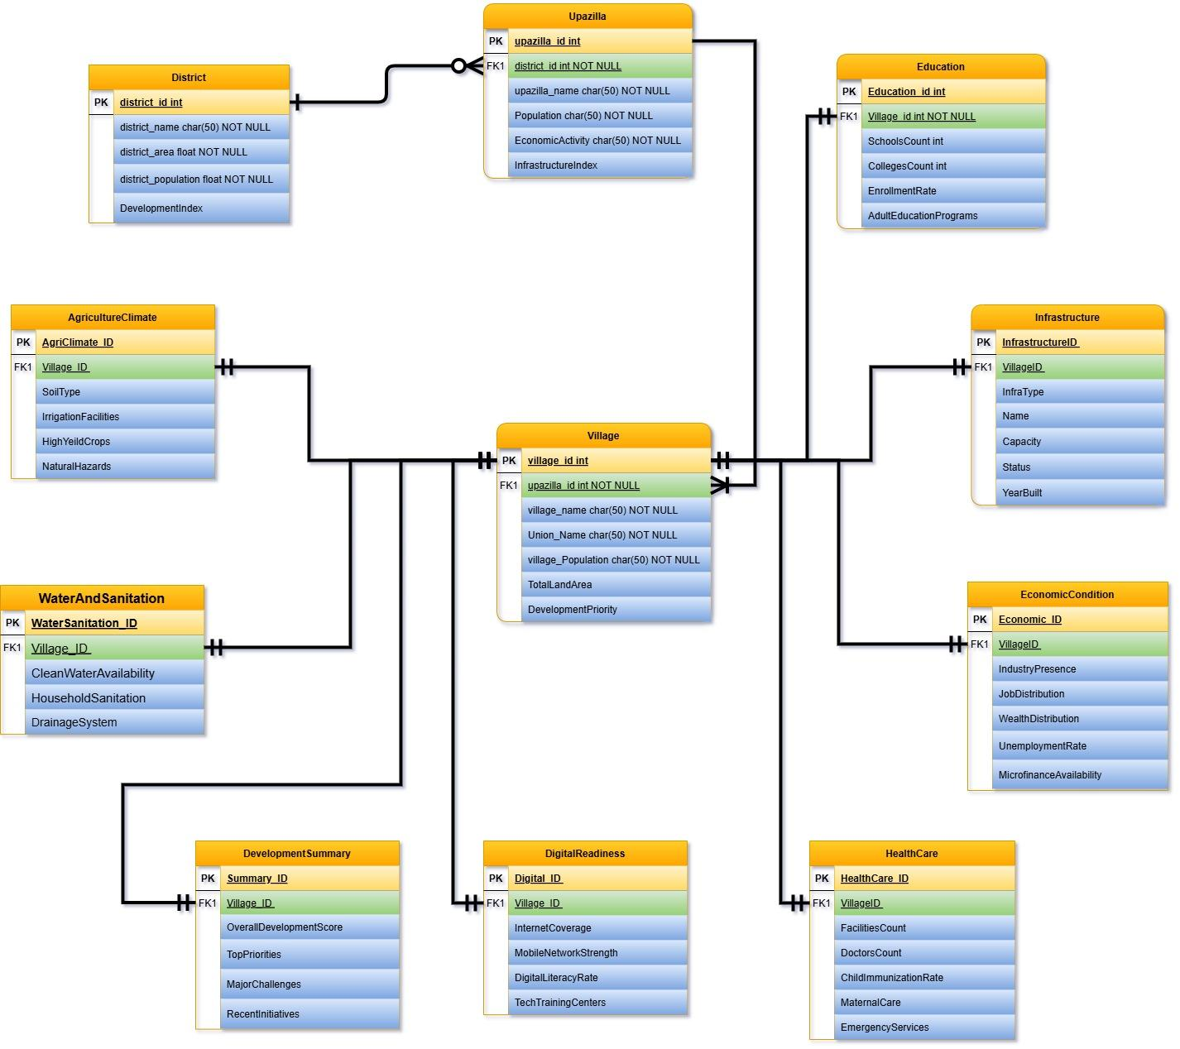
Schema Diagram
Detailed schema of the database design
Highlights primary keys, foreign keys, and relationships

Slide 8
Key Entities and Attributes
District
Attributes: DistrictID, Name, Area, Population, DevelopmentIndex
Upazila
Attributes: UpazilaID, DistrictID, Name, Population, InfrastructureIndex
Village
Attributes: VillageID, UpazilaID, Name, Population, DevelopmentPriority
Infrastructure
Attributes: InfrastructureID, VillageID, InfraType, Name, Capacity, Status, YearBuilt
EconomicCondition
Attributes: EconomicID, VillageID, IndustryPresence, JobDistribution, WealthDistribution, UnemploymentRate, MicrofinanceAvailability
Education
Attributes: EducationID, VillageID, SchoolsCount, CollegesCount, LiteracyRate, EnrollmentRate, AdultEducationPrograms
Healthcare
Attributes: HealthcareID, VillageID, FacilitiesCount, DoctorsCount, ChildImmunizationRate, MaternalCare, EmergencyServices

Slide 9
Key Entities and Attributes
WaterAndSanitation
Attributes: WaterSanitationID, VillageID, CleanWaterAvailability, HouseholdSanitation, DrainageSystem
DigitalReadiness
Attributes: DigitalID, VillageID, InternetCoverage, MobileNetworkStrength, DigitalLiteracyRate, TechTrainingCenters
AgricultureAndClimate
Attributes: AgriClimateID, VillageID, SoilType, IrrigationFacilities, HighYieldCrops, NaturalHazards
DevelopmentSummary
Attributes: SummaryID, VillageID, OverallDevelopmentScore, TopPriorities, MajorChallenges, RecentInitiatives

Slide 10
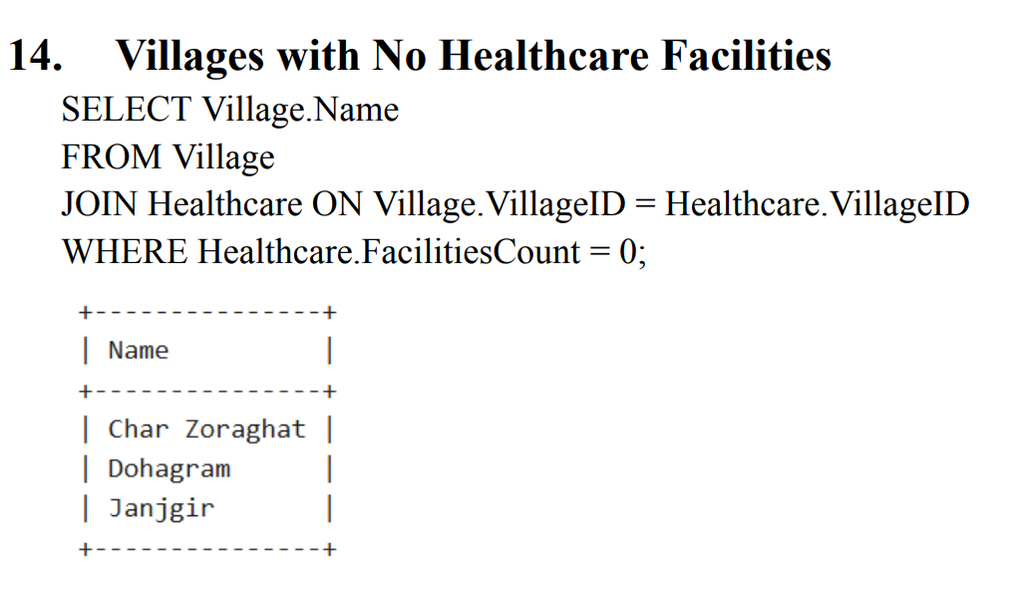
Some Query

Slide 11
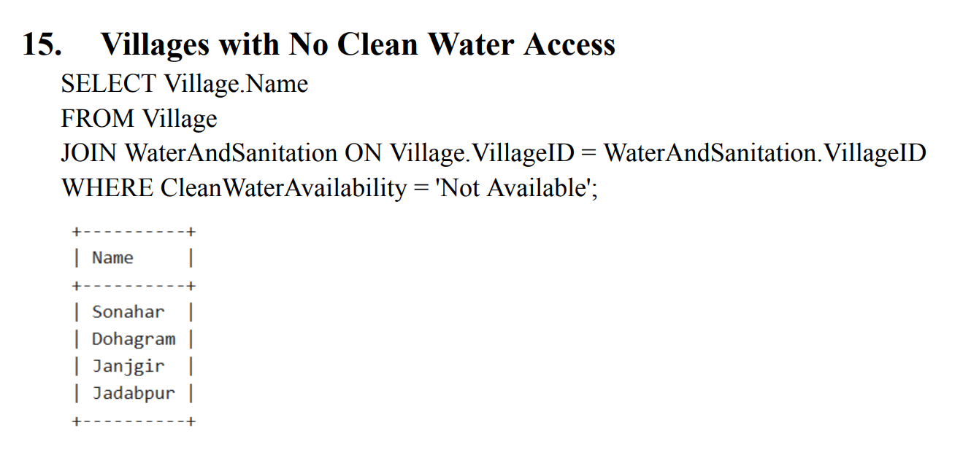
Some Query

Slide 12
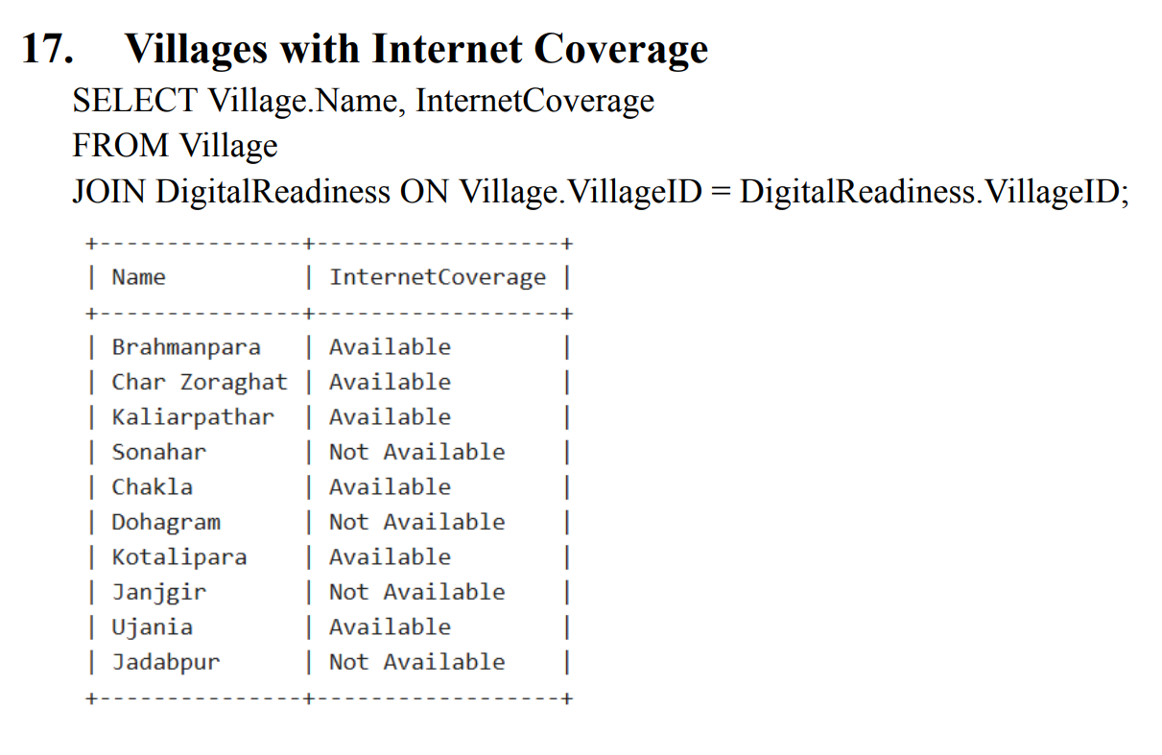
Some Query

Slide 13
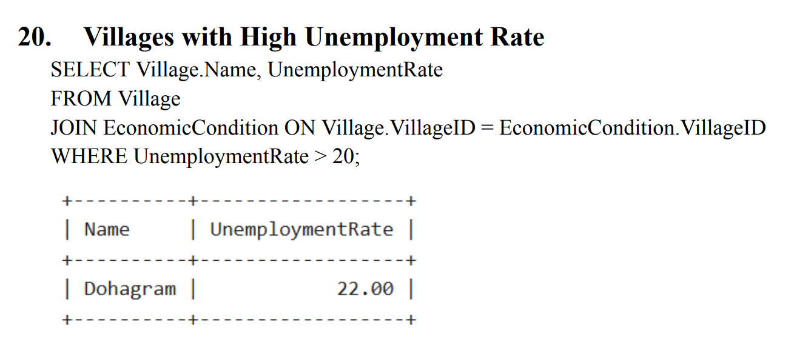
Some Query

Slide 14
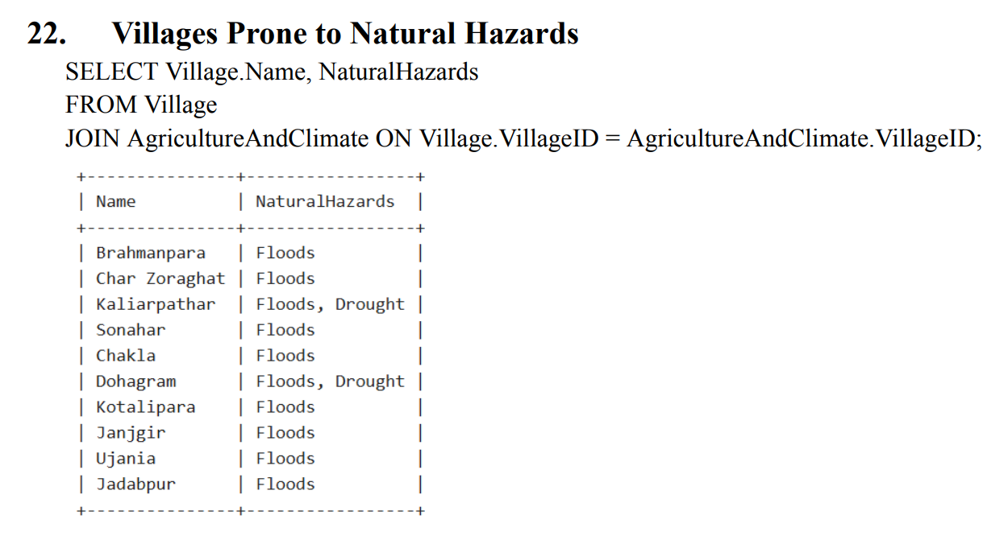
Some Query

Slide 15
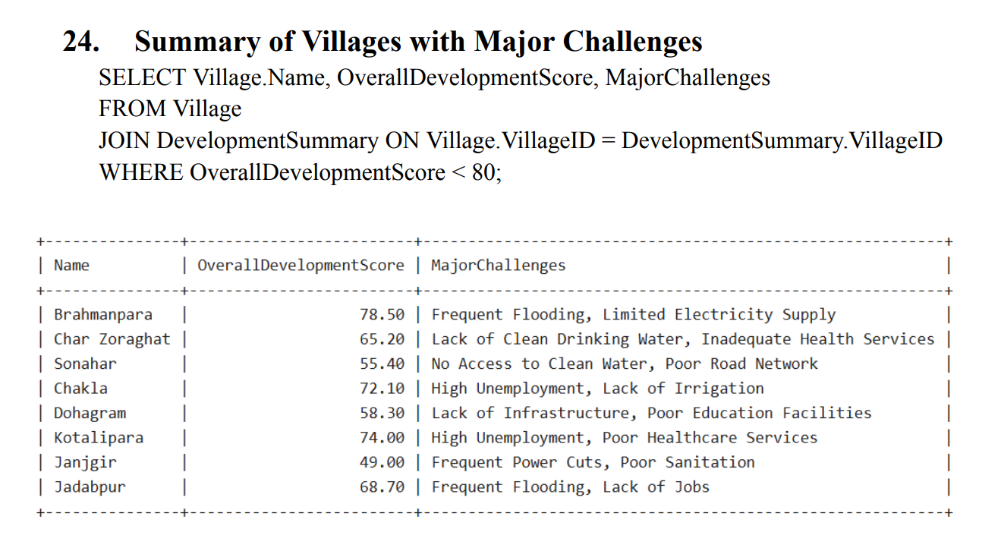
Some Query

Slide 16
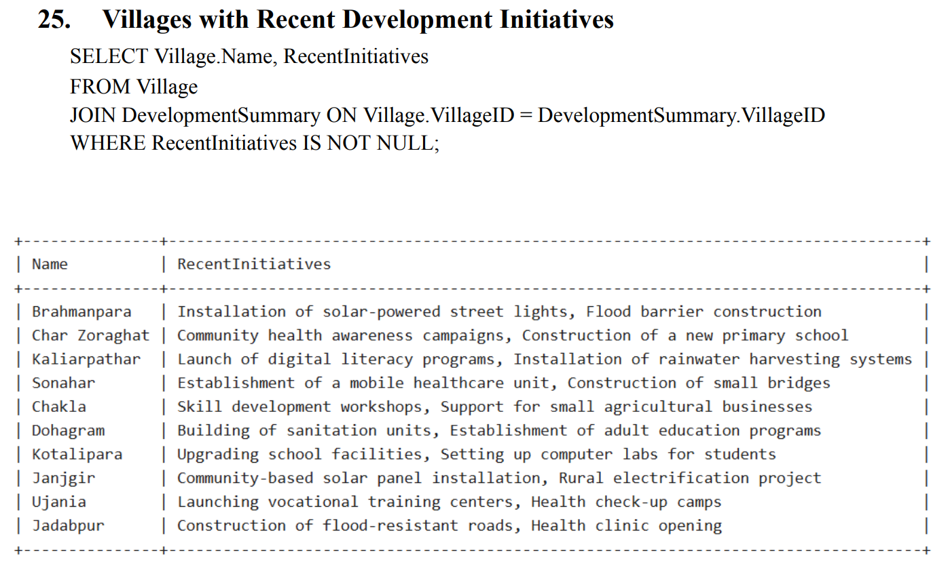
Some Query

Slide 17
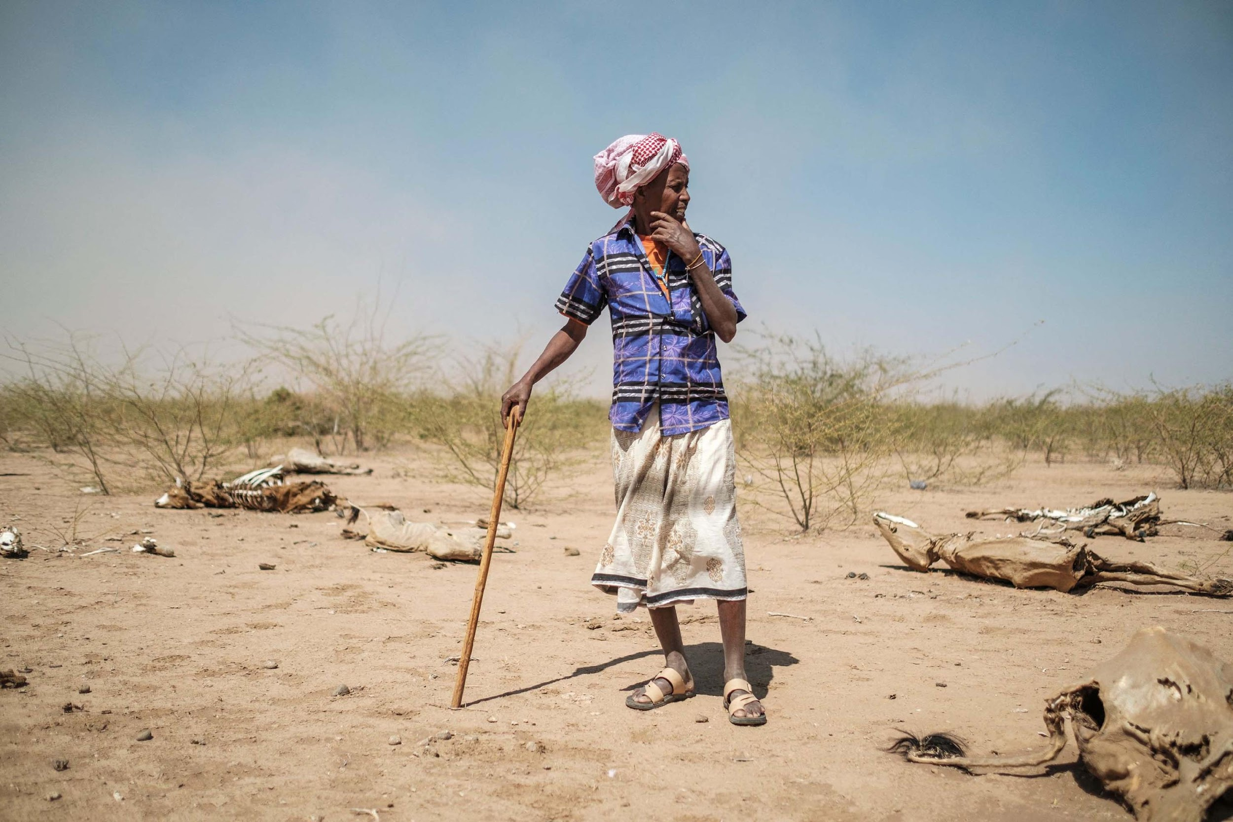
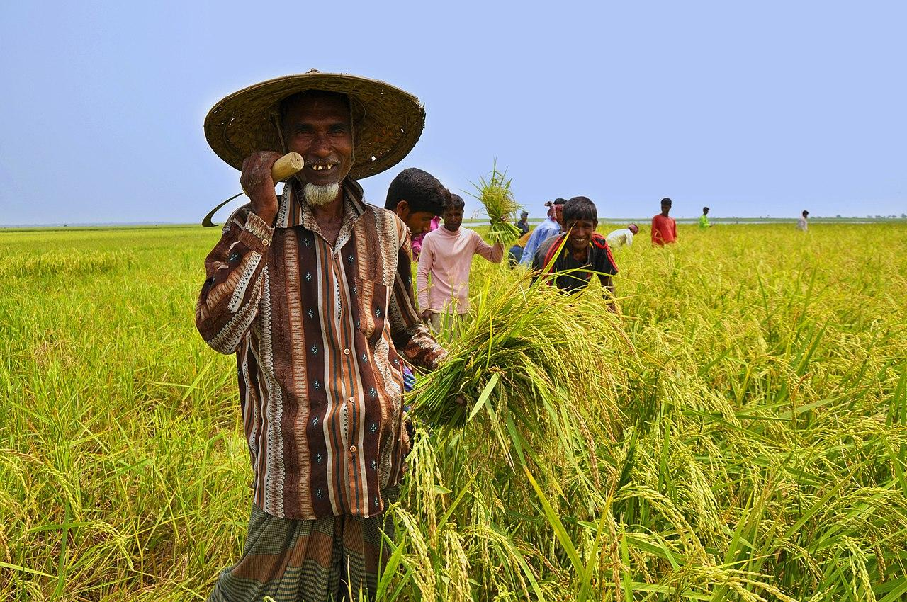
The Land is Life

Slide 18
THANK
YOU

